Slide 1
Spermseq TwinStrand Duplex Sequencing Panel Reference Slides
Jason Kunisaki
3/23/2021
University of Utah School of Medicine

Slide 2
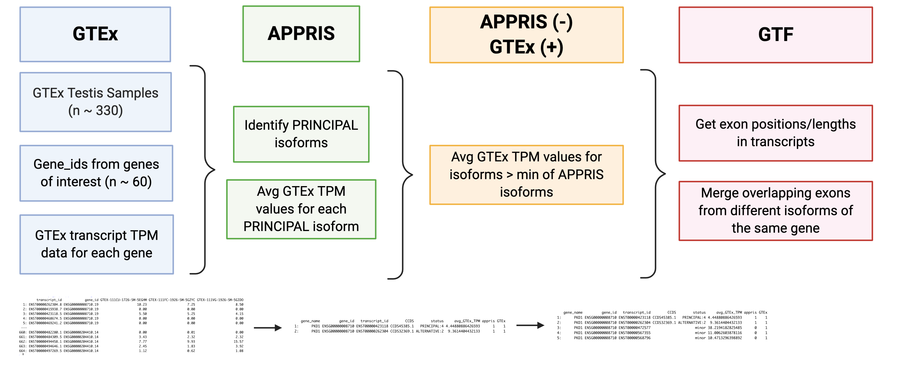
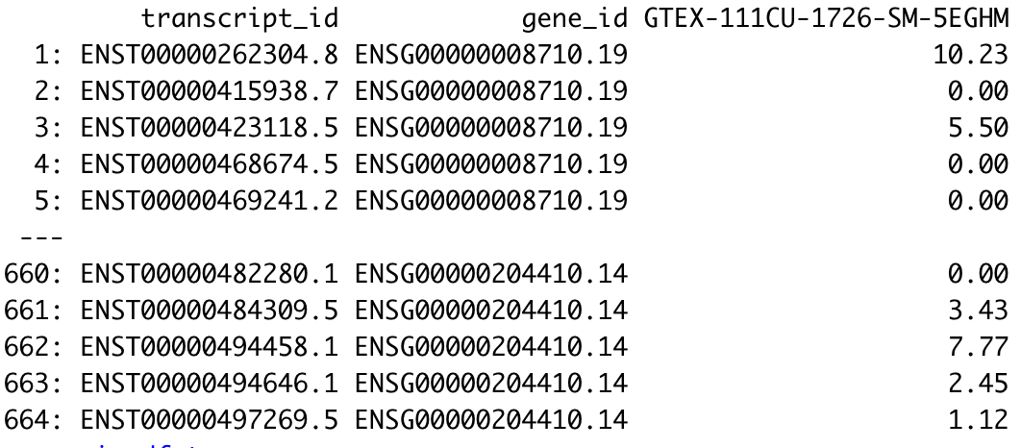
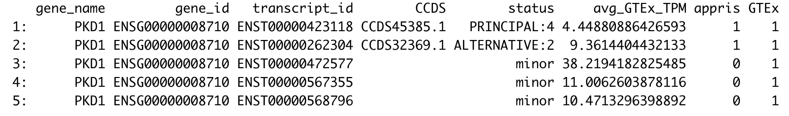
Inclusion criteria for transcripts
*in testis

Slide 3
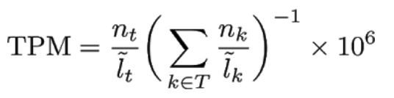
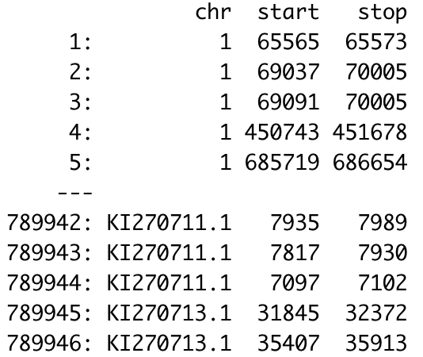


Important files
GTF file
gene_names
gene_ids
transcript_ids
exon positions
APPRIS file
Functionally important isoforms/transcripts
Proteomics
Cross-species conservation
GTEx file
Tissue specific gene expression
~330 testis samples
Manuel Rodriguez et al, 2017

Slide 4
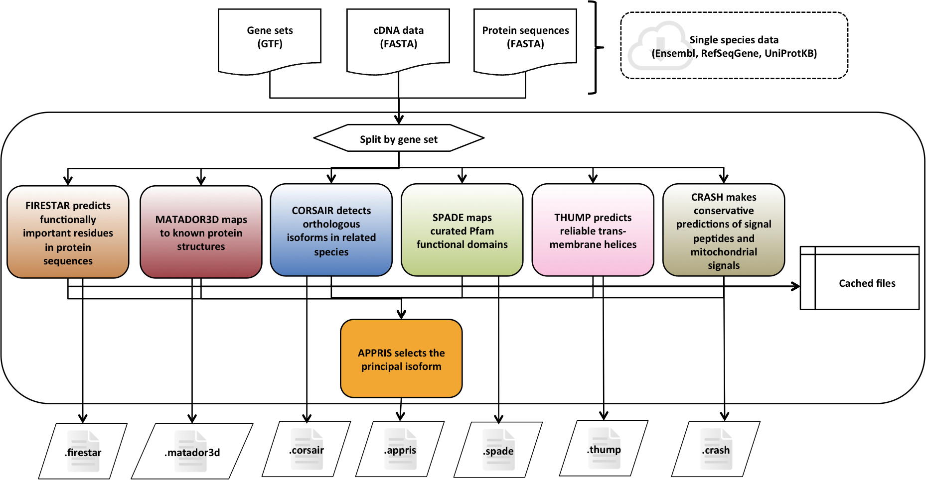
APPRIS – Functionally Important Isoforms

Slide 5
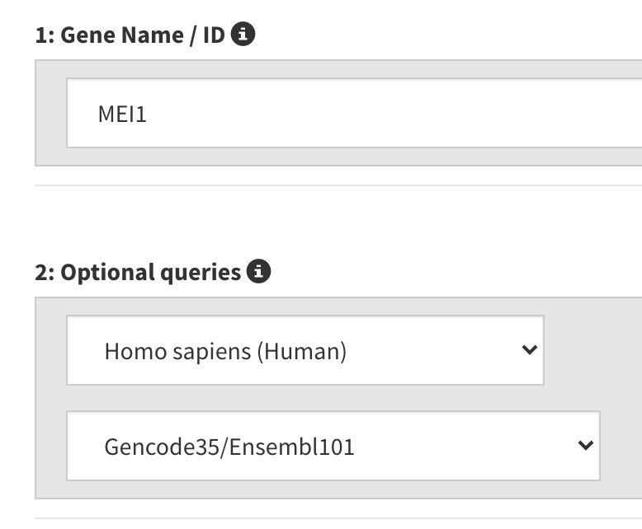
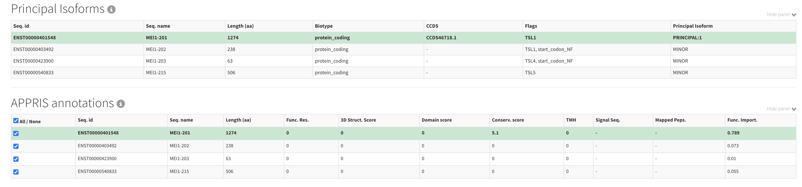
APPRIS – Example with MEI1
MEI1 Genome Browser Link

Slide 6
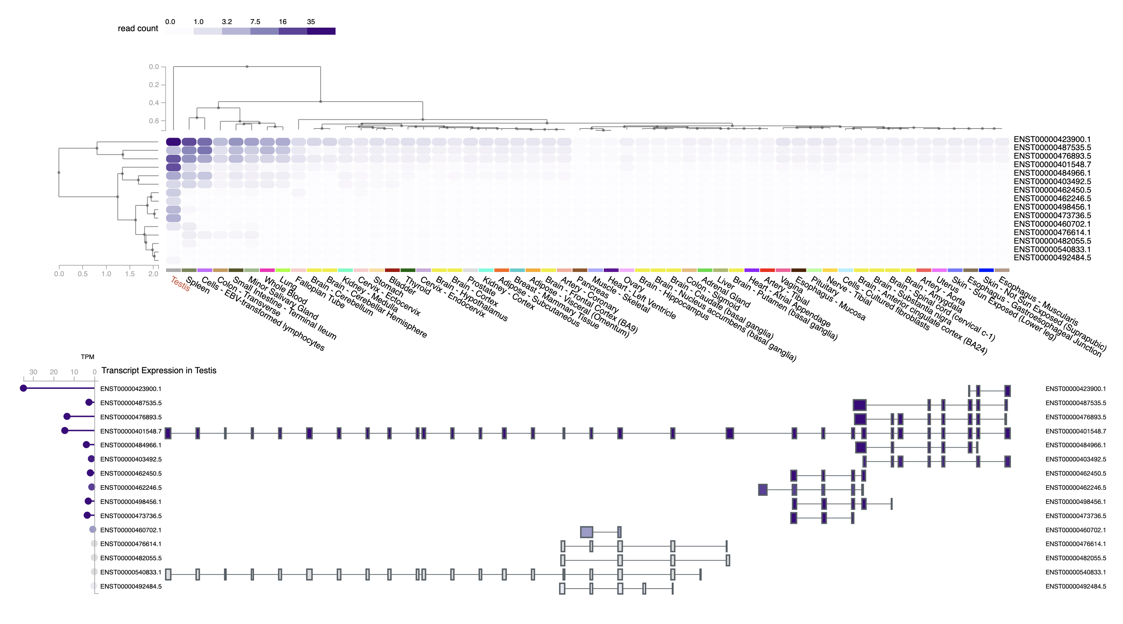
GTEx – Target Gene Expression in Testis
GTEx – Example with MEI1

Slide 7
Genomic coordinates of coding sequences from GTF
GTF file from ensembl release 102 (same as APPRIS and biomaRt functional annotation)
zless Homo_sapiens.GRCh38.102.gtf.gz | grep -w "CDS" > Homo_sapiens.GRCh38.102.CDS.gtf
Get exons/other GTF data belonging to genes of interest
cat Homo_sapiens.GRCh38.102.CDS.gtf | grep -w "gene_name \"[gene]\""

Slide 8
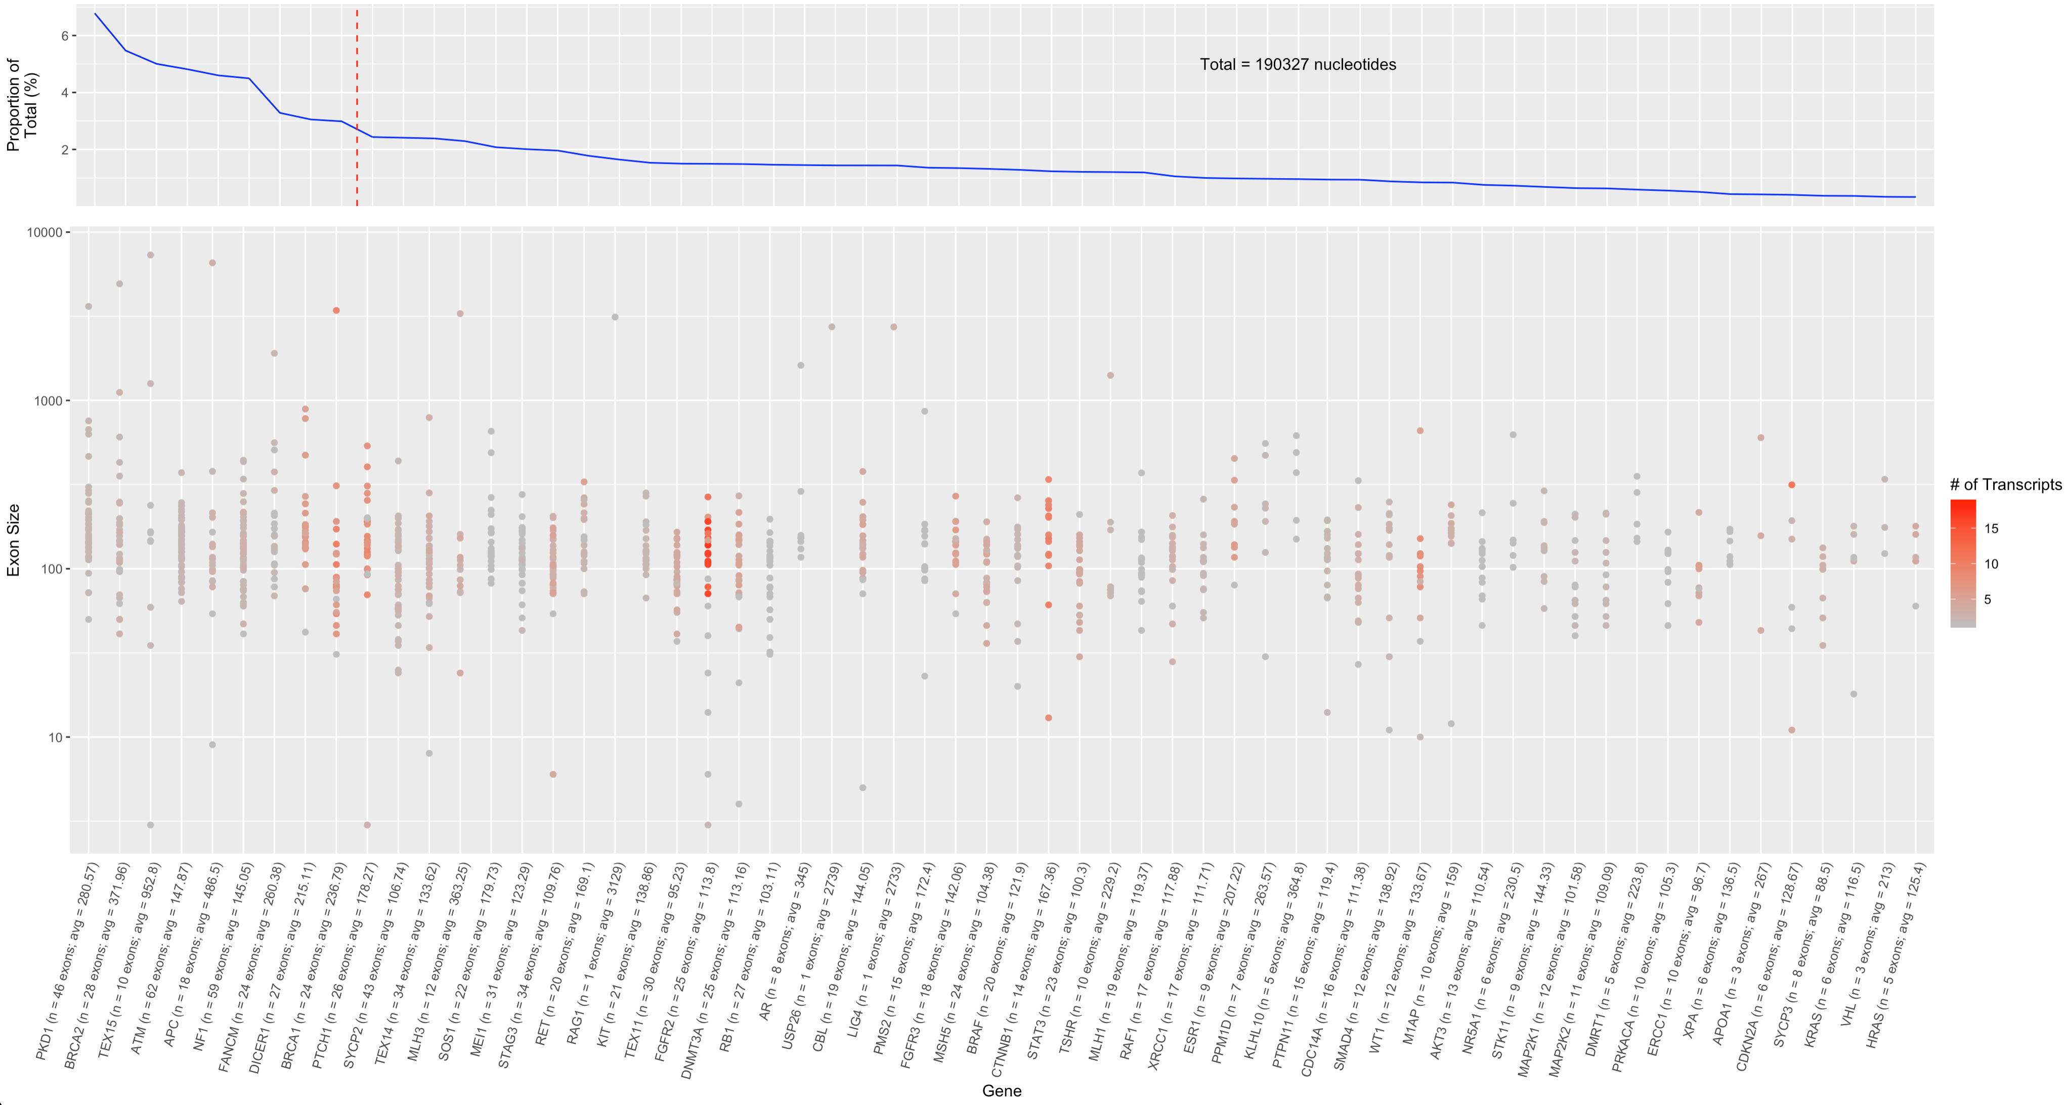
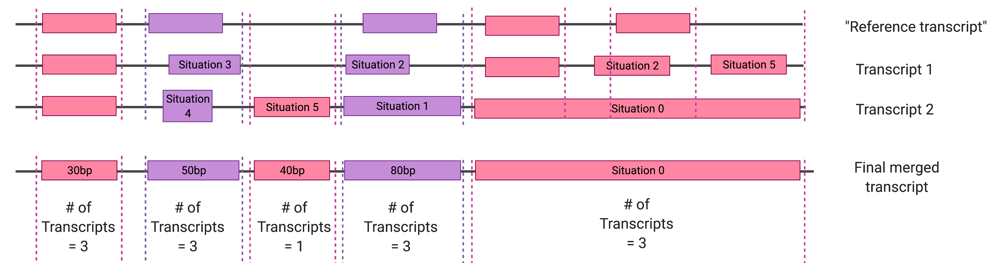
“Master” transcript generation
Account for the fact that a single gene can have multiple isoforms
Each isoform can have different #/location of exons
Merge all exon coordinates across all transcripts for a given gene
1
1
1
1
2
2
2
2
3
3
1
3
3

Slide 9
Summary Table
Filename | Gene number Ideal = 76 genes | Total panel size | Average # of “master” exons per gene
merged_exons_all_genes.bed | 76 | 152,274 bp | 10.2
merged_exons_some_moderate_genes.bed | 72 | 139,056 bp | 10.1
merged_exons_no_moderate_genes.bed | 67 | 130,959 bp | 10.1

Slide 10
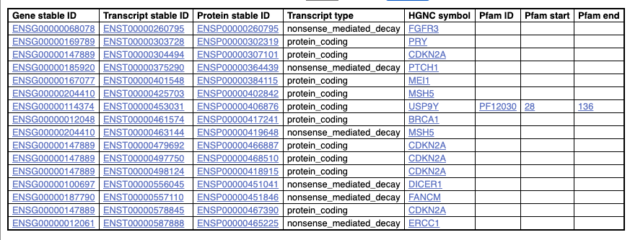
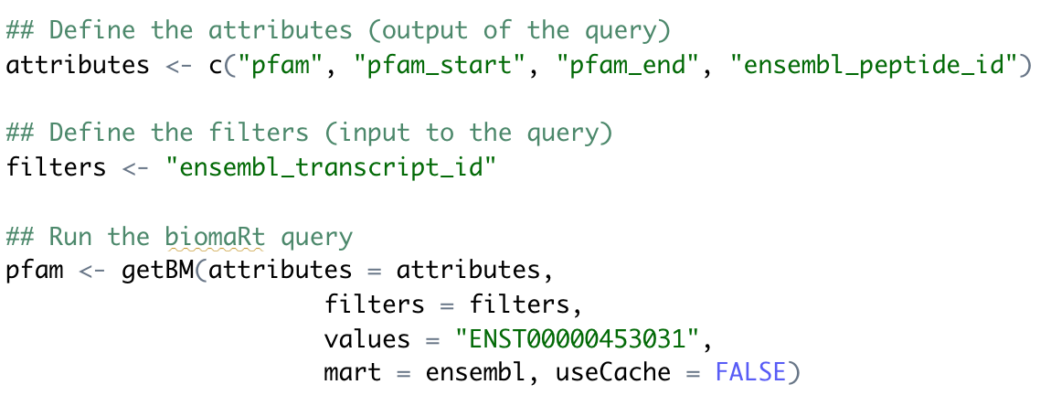
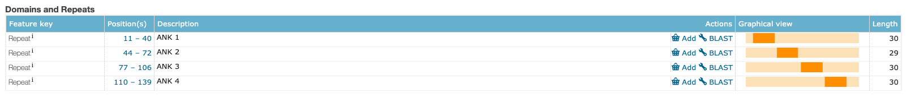
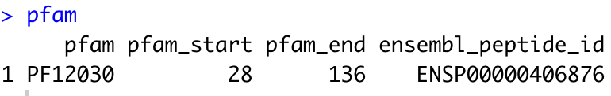
Annotation of functional domains
Used biomaRt in R (green)
Used ensembl release 102 which matches the GTF and APPRIS file
The “blank” domains were manually annotated with Uniprot for protein_coding transcripts (see below)

Slide 11
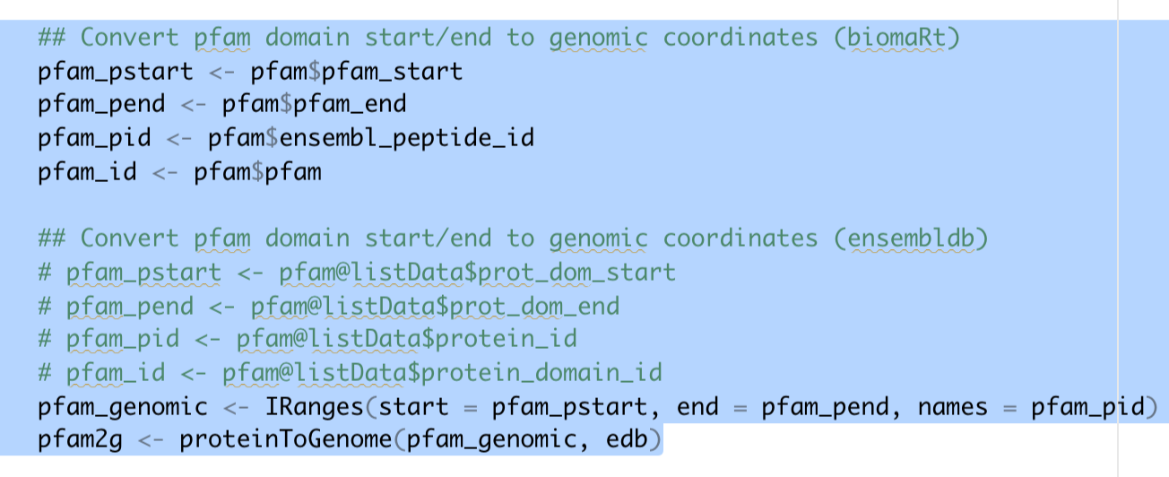
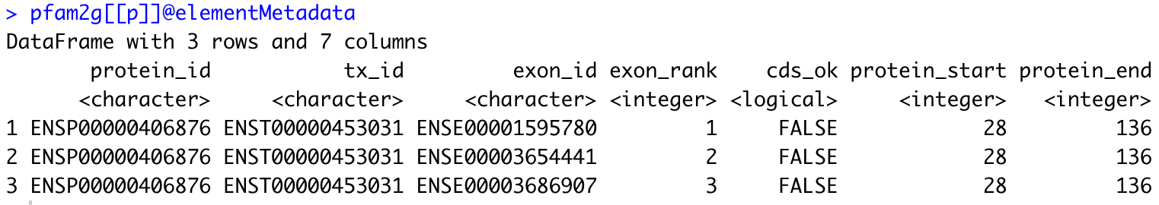
Mapping protein coordinates to genomic coordinates
Used ensembl release 101 for this step → this is the latest version available on R
How I dealt with this:
1) Ignored functional domain coordinates and included all coding sequence exons for the transcript
2) Looking at other algorithms such as jvarkit

